Slide 1

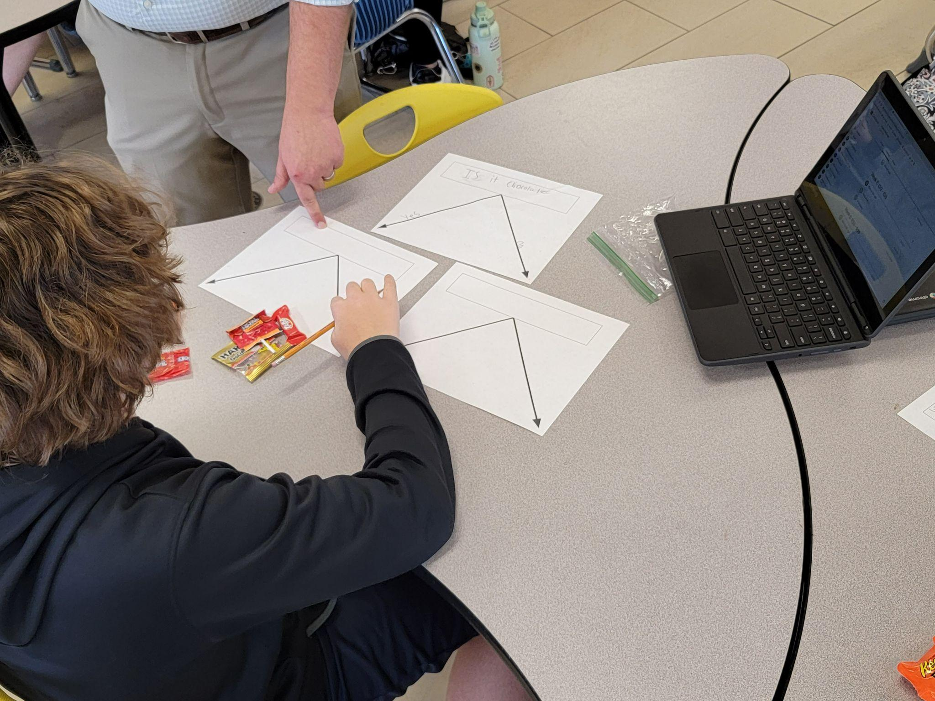

Module 3.2
How can a computer learn to classify objects from examples?
Living and Working with Artificial Intelligence
Developed for the AI4GA (Artificial Intelligence for Georgia) project funded by National Science Foundation awards DRL-2049029 and DRL-2048502.
This work is licensed under the Creative Commons. Attribution-NonComercial-ShareAlike 4.0 International License. https://creativecommons.org/licenses/by-nc-sa/4.0/

Slide 2
Try It #1: Candy Land - Creating a Candy Classifier
Setup: (a) Print out pages with a box and two arrows (link) or use a large sheet of poster paper ;
(b) eight pieces of candy that you can move around the nodes of your tree.
Step 1: Pick a feature that will split the candy into two roughly equal groups
Doing this every time will give you the smallest number of questions
This is similar to how real machine learning algorithms decide which feature to use for the next node
Step 3: Take the features, build the decision tree.
Make sure every piece of candy is a leaf
You may not have enough features - if you end up with two pieces of candy at the same leaf
Step 4: Test this out and update the features and the tree
Step 5: Convert the tree into a table.
The columns are the features
The rows are the leaves
If the feature doesn’t apply, put N/A

Slide 3
Candy Decision Tree Implementation
Required materials:
8 pieces of individually wrapped fun sized candy per group of two to four students ( What I had was four candies that were chocolate, and four that were not, but anything will work )
7 printed decision trees per group (Last page of this document)
8 notecards / sticky notes for each group
Floor / table space to work as students will need space to lay out their tree.
Implementation:
Tell students that they will be getting a piece of candy at the end of class so that they will focus on the task.
Start by asking students what their science teacher would be looking for if they asked students to deceive the features of a bird (Color, beak shape, size, etc.)
Using one index card per piece of candy, ask the students to write down the features of each piece of candy.
Have students take out their first decision tree. Tell them to write the word “Yes” by the line going down to the right and the word “No” by the line going down to the left.
Ask each group to develop a question that uses their features to split the candy into two equal groups. Have each group move each candy and notecard to the end of the correct yes or no arrows.
Discuss what each group used as their first question (My class used chocolate or not)
Have students take out two more decision trees and place them below the yes and now arrows
Have students write in yes and no beside the lines like before, and develop a new question to split each of the two groups as equally in half as possible.
Have students repeat this process, adding papers and questions until each candy is on its own at the end of an arrow.
Have students move all of their candies above their first question, and then move to another groups decision tree
Have students use the other group’s tree to sort the candies, moving the candies through the yes / no questions and paths. Tell students to do exactly what the question says. Be strict! IT IS NORMAL AND OK FOR THINGS NOT TO WORK!!!!!
Tell students to leave the candies where they end up on the tree, and then have students go back to their decision tree.
Have students make any changes they need to make to their questions
Move the candies to the top of the tree, and then move to a different decision tree than they checked before
Repeat the process of checking the other groups tree
Have students go back to their original tree and make any final changes
Document the trees by taking a picture of each group’s tree.
Let the groups split up the candy or give them a piece
Discussion for the next day / wrap up
Define terms
  Features
  Root node
  Decision node
  Leaf nodes
Explain usefulness in real life

Slide 4
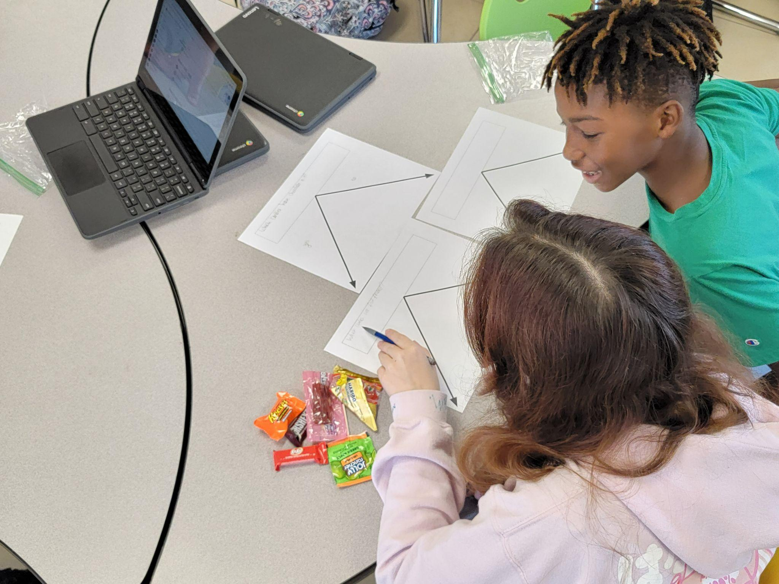
Setup: Distribute Candy
Reeses cup
Hershey Bar
Jolly rancher lollipop
Twizzler
Gummies
Kitcat

Slide 5
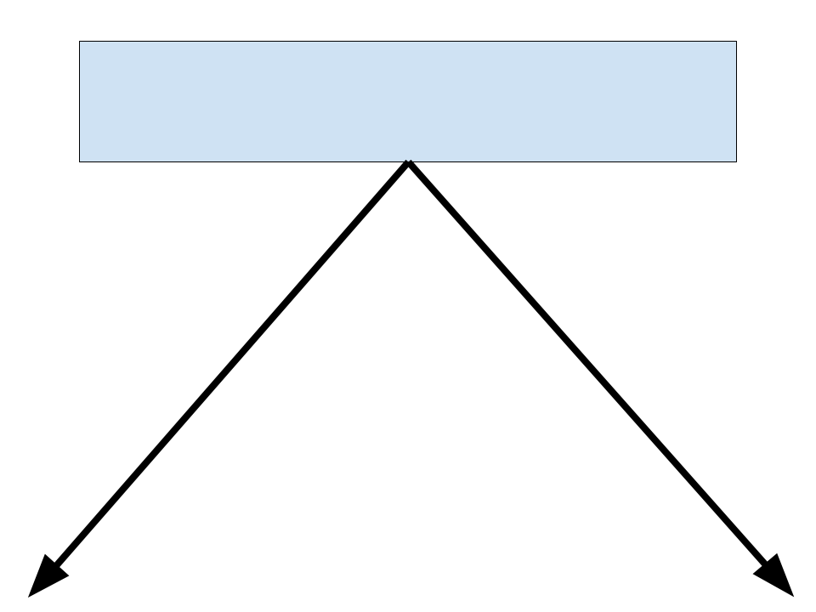

Slide 6
Step 1:
List all the features you think may be useful to distinguish the candy.
Step 2: Create a root node and place all the candy there.
Step 3: Pick a feature from the list that splits the candy examples in the current node roughly in half.
A feature is a property of a thing we are trying to describe.

Slide 7
Step 4: Create two children of the current node and split its candy between them based on the feature.
Yes
No

Slide 8
Step 4: Create two children of the current node and split its candy between them based on the feature.
Is it long?
Yes
No
Yes
No

Slide 9
Now that we’ve created our classifier
We can describe pasta using feature vectors.
A feature is a property of a thing we are trying to describe.
A featurE Vector is an ordered list of properties.
Our feature vector:
candy | Is it long? | Is it wide? | Is it stuffed?
Notes:
This is the same idea of the semantic space of the word embedding vectors
Except in the word embedding vector - the computer figures out the features
These features dont’ have to be binary, it might have a numerical value
Is the length > of pasta

Slide 10
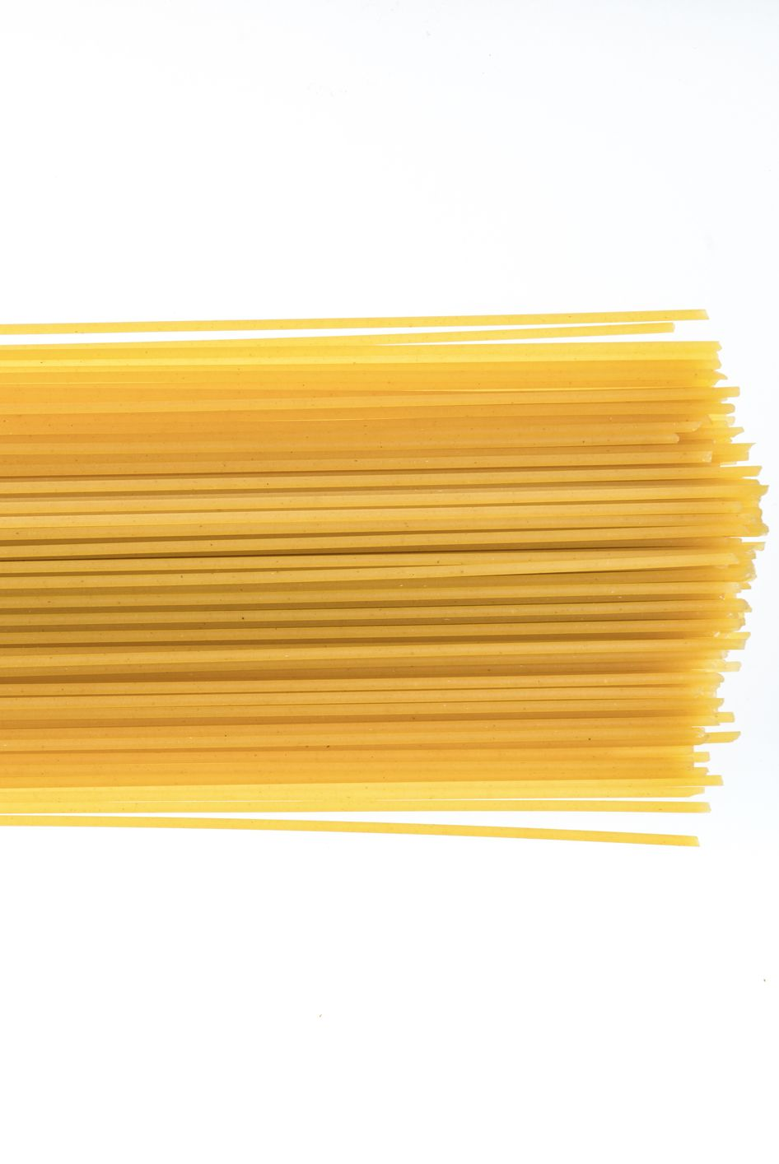
Feature Vector Description of Pasta
We’ve created a language for describing pasta that is useful for machine learning.
Your data is a feature vector - it isn’t a picture of pasta.
Candy | Is it long? | Is it wide? | Is it stuffed?
Spaghetti | Y | N | N
Lasagne | Y | Y | N
Rigatoni | N | N | N
Ravioli | N | Y | Y
Connection to Module 2.5 - Word Embeddings - Our feature vectors for pasta is similar to the semantic space of the word embedding vectors we interacted with in the demo. Since word embeddings have many features (300) the computer figures out the features.
Notes:
This is the same idea of the semantic space of the word embedding vectors
Except in the word embedding vector - the computer figures out the features
These features dont’ have to be binary, it might have a numerical value
Is the length > of pasta

Slide 11
Use this test set to see how good your features are at classifying a new piece of candy

Slide 12
Feature Vector Description of Candy
Candy
Spaghetti
Lasagne
Rigatoni
Ravioli
Notes:
This is the same idea of the semantic space of the word embedding vectors
Except in the word embedding vector - the computer figures out the features
These features dont’ have to be binary, it might have a numerical value
Is the length > of pasta

Slide 13
Test Set - Data Collection Sheet
Candy | Correctly classified | Incorrectly classified
Spaghetti
Lasagne
Rigatoni
Ravioli

Slide 14
Reflection
How well did your candy classifier do on this new test set? What candy did it classify incorrectly?
Were your features flexible enough to allow you to classify new candy? Why or why not?
How would you change your features to allow them to better classify a wider range of candy?

Slide 15
Feature Vector Description of Pasta
Add more columns to fit all your features & more rows to fit all your pastas
Pasta
Spaghetti
Lasagne
Rigatoni
Ravioli
Notes:
This is the same idea of the semantic space of the word embedding vectors
Except in the word embedding vector - the computer figures out the features
These features dont’ have to be binary, it might have a numerical value
Is the length > of pasta

Slide 16
Takeaways

Slide 17
If your data is in a feature vector table like this then you don’t have to build the tree yourself
People don’t usually build decision trees by hand because for realistic tasks it can be hard.
For practical problems, people build a table that may have thousands of rows (examples) and dozens of columns (features). Each example is labeled with the correct decision (i.e., the class it belongs to).
Then they use a machine learning algorithm to create the decision tree.
Machine Learning is a process for constructing a reasoner (such as a decision tree classifier) using training data and a learning algorithm.

Slide 18
Candy Land vs Mini-Akinator
Candyland is a simulation of a machine learning algorithm
We knew all the examples/classes in advance
We knew all the features in advance
When we constructed the tree
  We used node splitting process
  We were selective about the features we chose in our tree
Used an algorithm to build the tree
Take away - The new way we build the tree in Pasta Land is what a machine learning algorithm will do for you.
Mini-Akinator - simulation of creating and growing a decision tree
We didn’t know the examples in advance
We didn’t know all the features in advance
Instead we added the examples one at a time and discovered the features as we went along
When we constructed the tree
  We grew it step by step because we added a new example
We couldn’t predict what to ask until we had another example
We might have to ask a lot more questions using this process.
Take away - We learned how to create and grow a decision tree and get some insight into how Akinator works.

Slide 19
Let’s look at some examples from the real-world

Slide 20
Try It #2: Think of a real-world example
Step 1: Pick a situation in the real world where computers might make decisions
Step 2: Think about the attributes that would contribute to making good decisions
Step 3: Reflection: Think about how your life is being affected by classifier systems (automated decision making).
Examples
Classifying toys based on age.
What kinds of features make a toy suitable?
Classify games, movies, and music
Reviewing loan applications.
What kinds of things help us determine the strength of a loan application?
College applications.
What kinds of things make for a strong college application?

Slide 21
Computers don’t learn the way people do.

Slide 22
How do people learn?
Discussion
Notes:
Answer - It solves a problem by asking a series of questions.

Slide 23
Ways people learn
Being taught by someone (e.g., parent, teacher, sibling, friend)
Asking questions
Observing others
Reading
Trial and error
Systematic experimentation
Everyday life experiences
Note: None of these are things that computers currently do well.

Slide 24
Ways Computers Learn
Learning from labeled examples (like Candy Land and Teachable Machine)
  This is called supervised learning
  We will only explore supervised learning in this unit
Finding clusters in data
  This is called unsupervised learning because the data does not come pre-labeled
  Example: examining data on plants collected from a forest and decided how many different species of plants there are in the forest
Learning from experience via trial and error
  This is called reinforcement learning
  This is how computers learn good strategies for playing games
Learning by being told
  This is called zero shot learning.
  Large language models like ChatGPT can learn a new task by being told what to do and they will follow those instructions.
Notes:
Note - Learning by being told has been added in April 27,2023 to accommodate the appearance of ChatGPT

